Slide 1

SalesMax.Ai
“Humanize processes for better opportunities”

Slide 2
DevilYouKnow
Mohammad Nurdin bin Norazan - Technical
Esa Ezzatinor bin Abdul Hamid - Business
Nurul Azrin binti Mohd Nasir – Quality Assurance

Slide 3
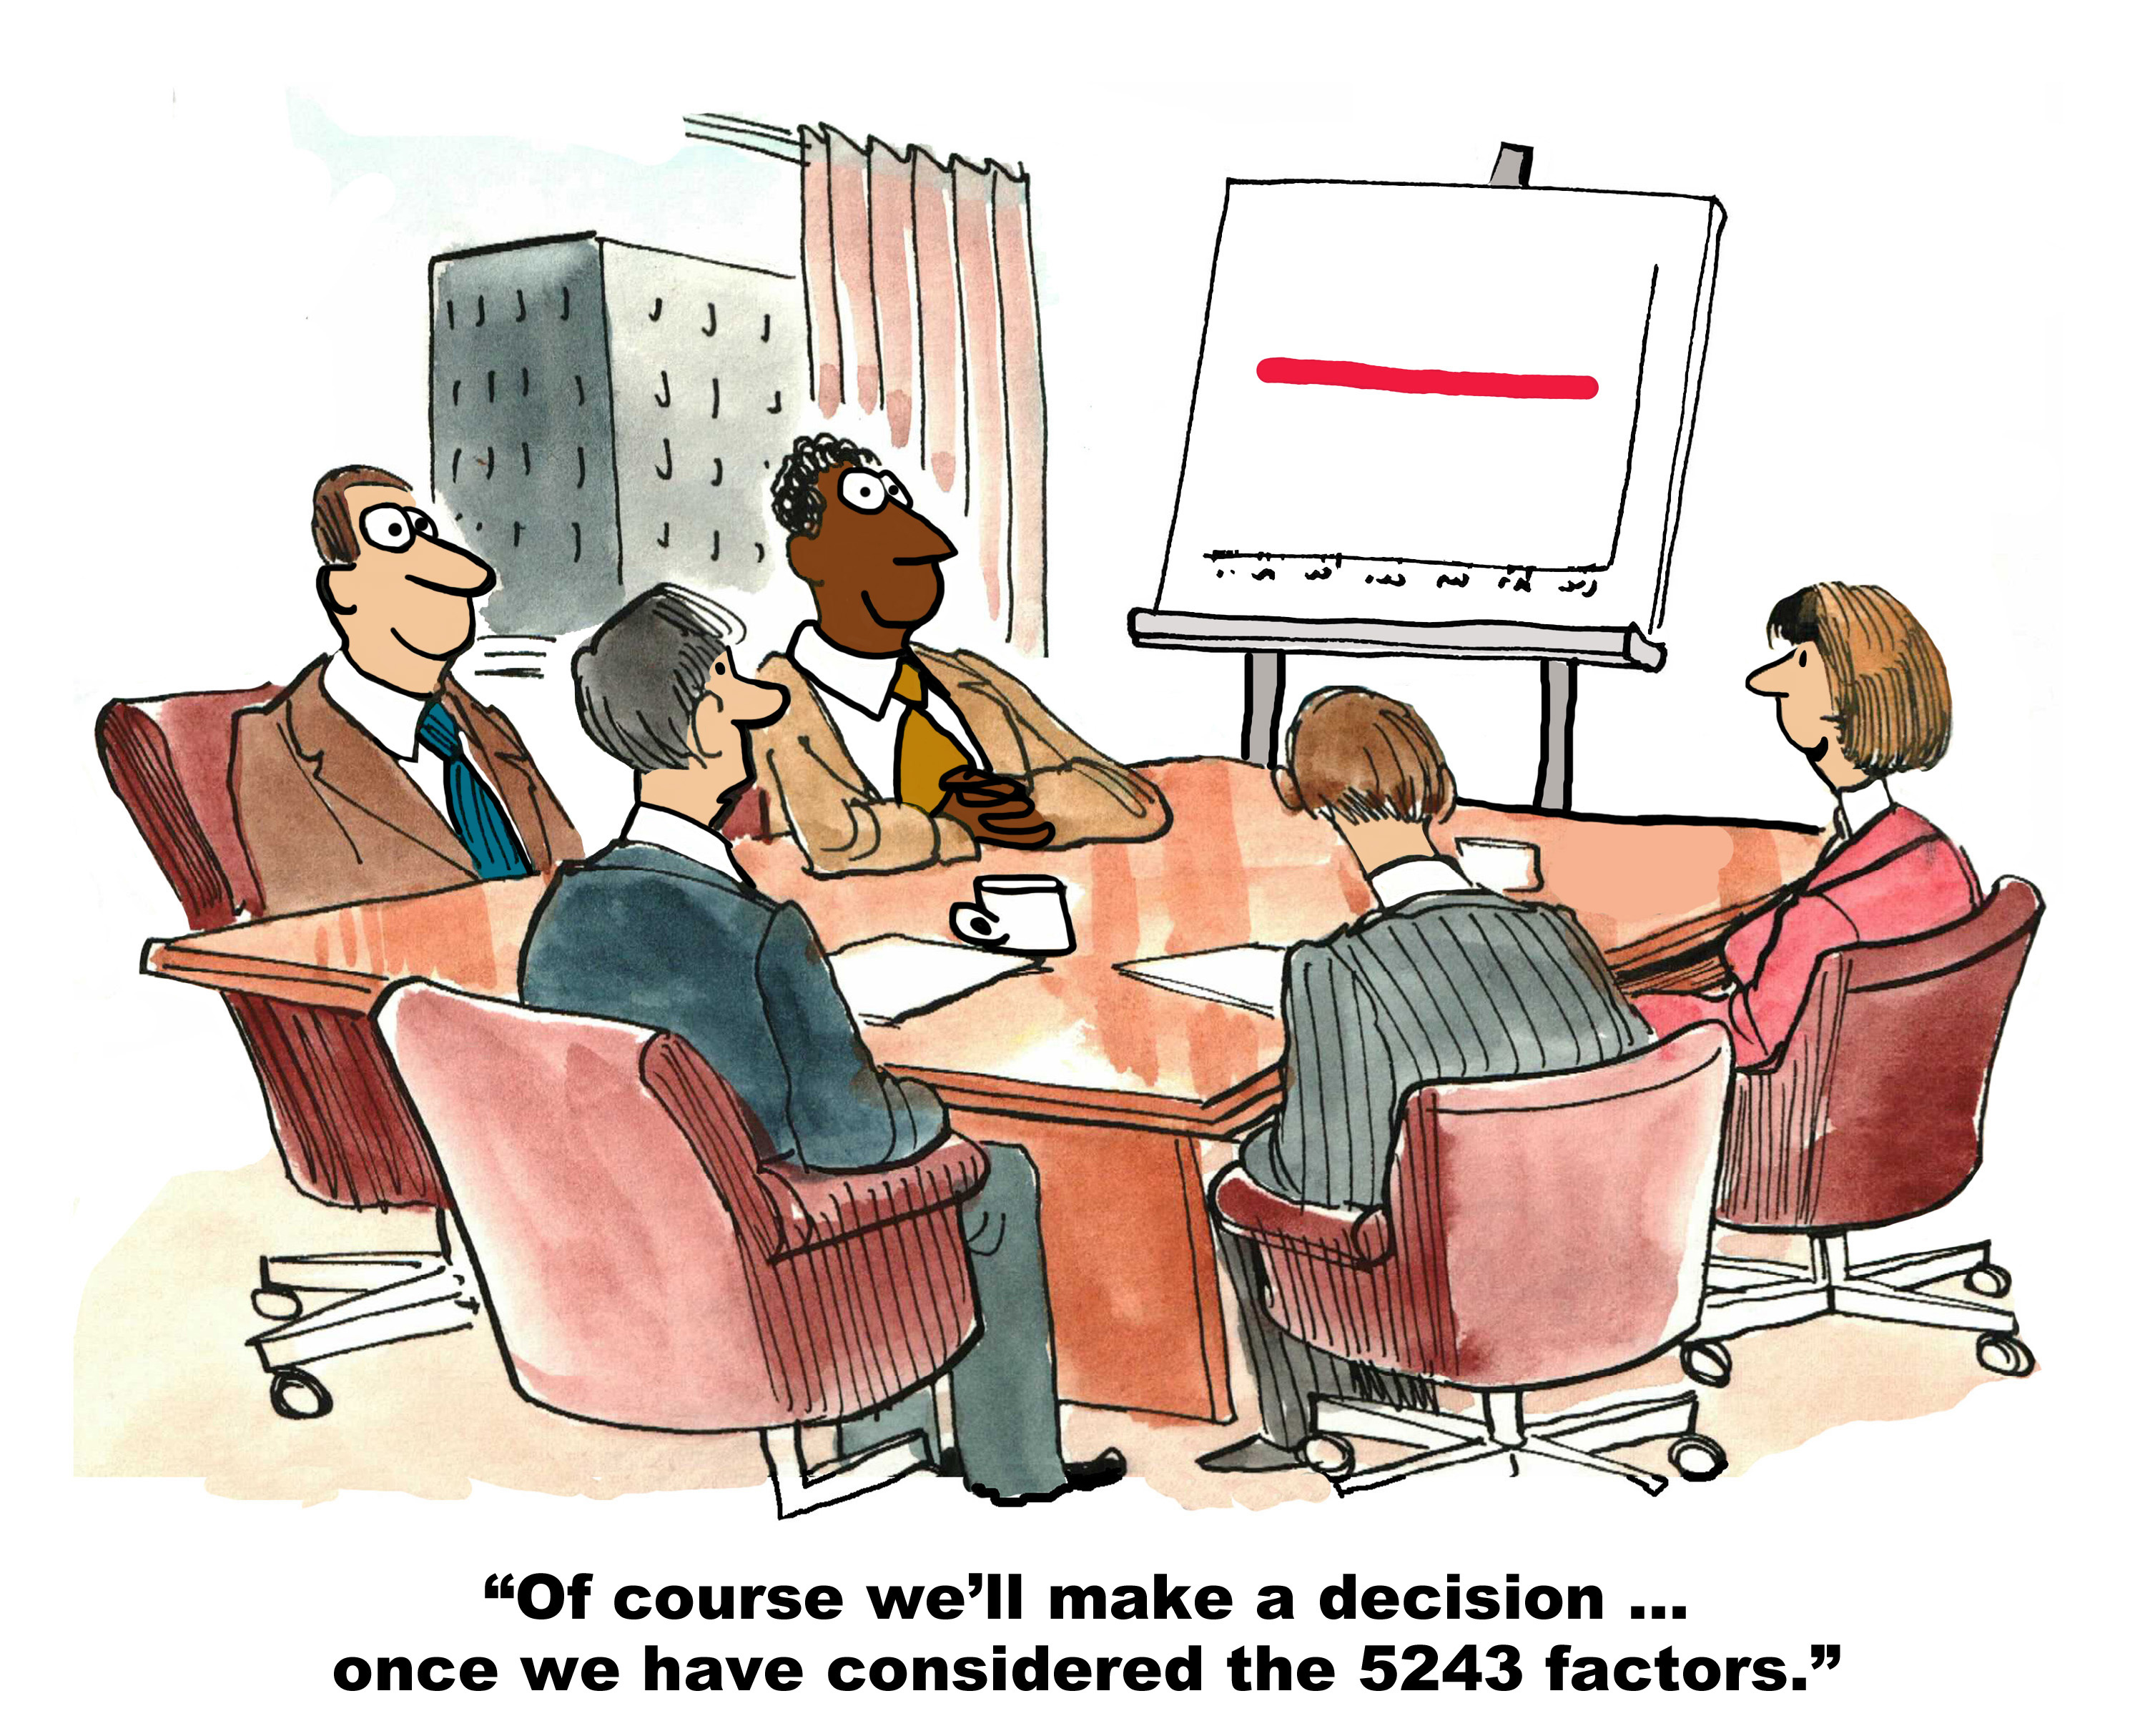

Slide 4
SalesMax.Ai
CRM – Opportunity Winning/Losing Rate
Cross Sell Analysis
Customer Retention Analysis
Sentiment Analysis

Slide 5
Tech Stack
Pandas
NumPy
Sklearn
IPython
Google Chart
Heroku
Beautiful Soup

Slide 6
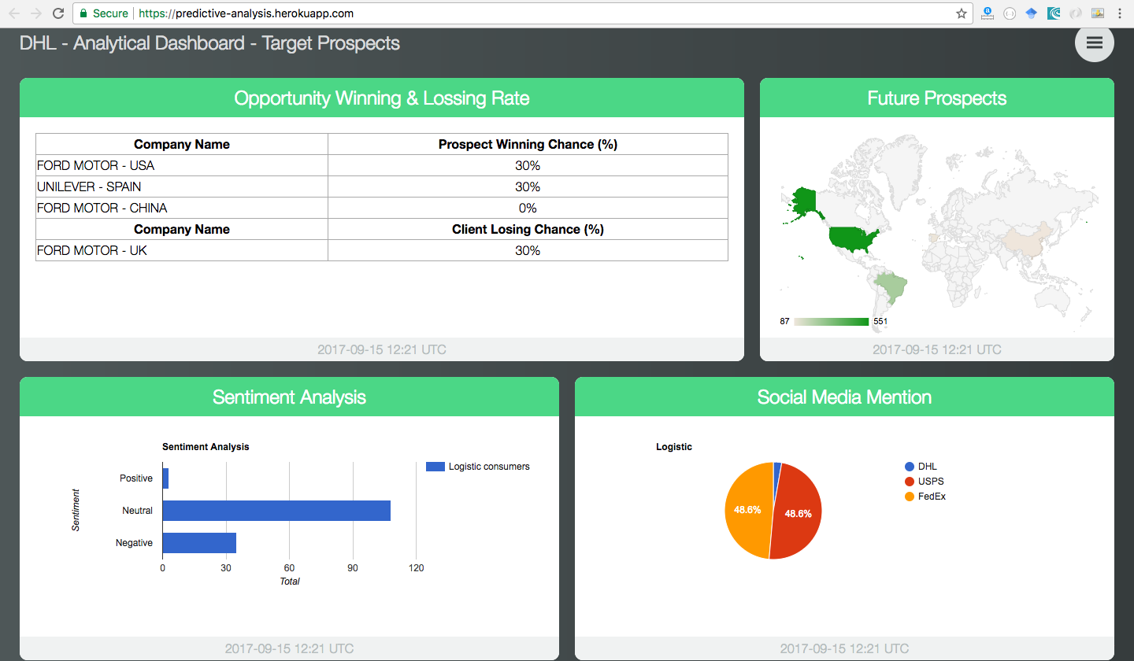
Demo - http://bit.ly/2x6eI02

Slide 7
Future Enhancement & Possible Improvement
Custom analytic dashboard (Drag & Drop)
Build & deploy dataset using CLI
Implement real time data with Big Data technology
Market movement
Deep integration with DHL CRM

Slide 8
Questions?

